Slide 1

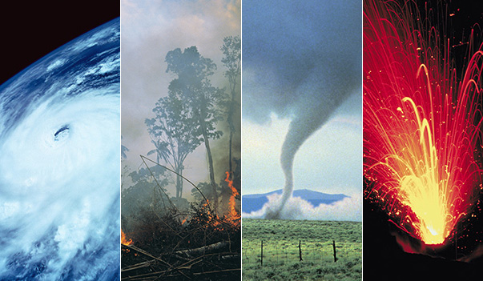
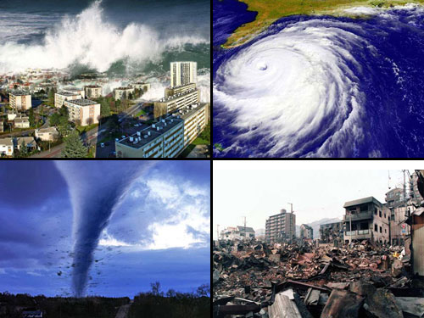
Natural Disasters
By Jahanvi

Slide 2

Definition of Natural Disaster
A natural disaster is a major adverse event resulting from natural processes of the Earth; examples include firestorms, dust storms, floods, hurricanes, tornadoes, volcanic eruptions, earthquakes, tsunamis, storms, and other geologic processes. A natural disaster can cause loss of life or damage property, and typically leaves some economic damage in its wake, the severity of which depends on the affected population's resilience and on the infrastructure available.

Slide 3
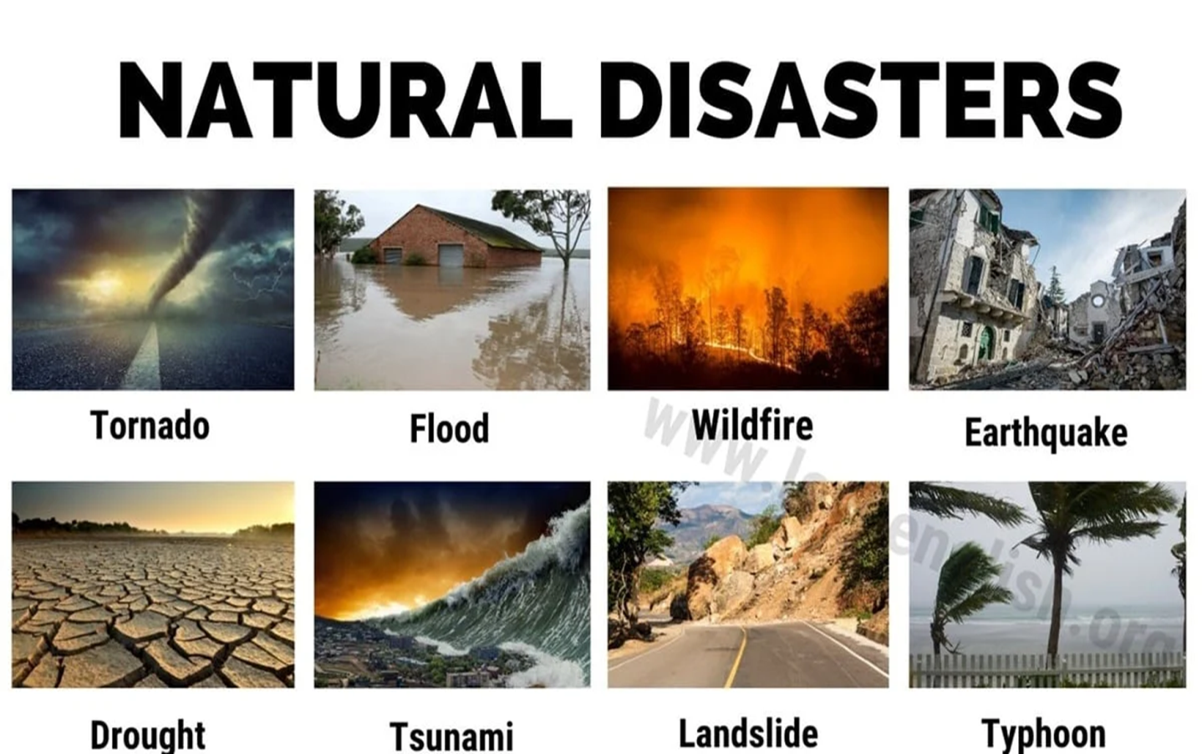
Examples:
Dust Storms, Floods, Tornadoes, Earthquakes, Tsunami, Storms, Land Slide, Drought, Wildfires and Typhoon.

Slide 4
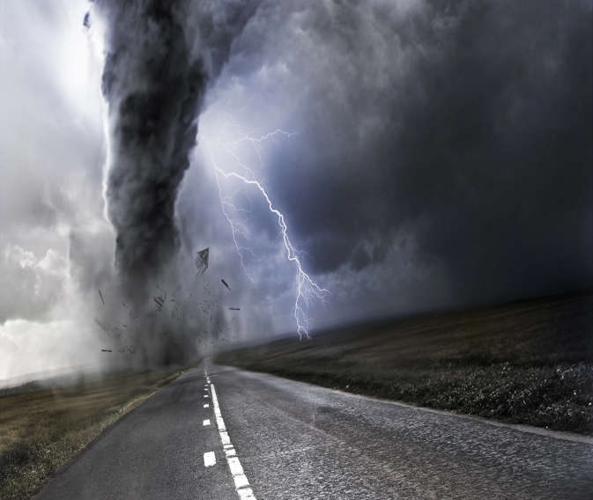
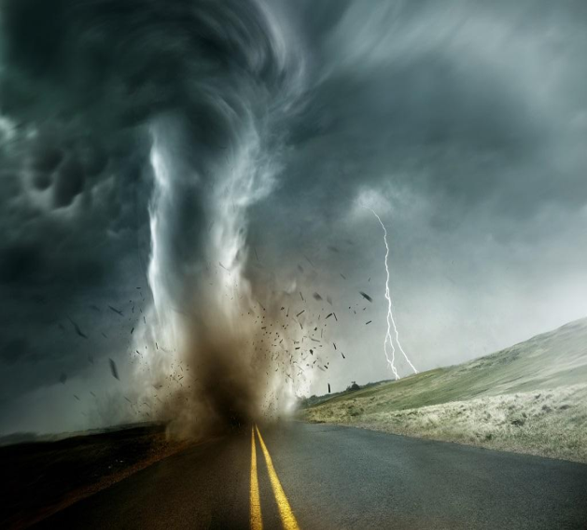
Tornado
A tornado is a violently rotating column of air extending from the base of a thunderstorm down to the ground. Tornadoes are capable of completely destroying well-made structures, uprooting trees, and hurling objects through the air like deadly missiles.

Slide 5
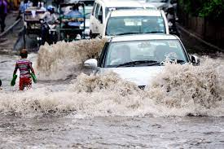
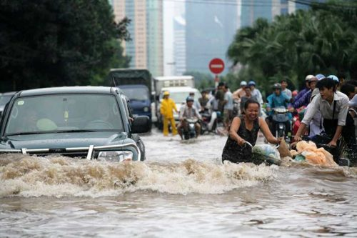
Flood
A flood is an overflow of water that submerges land that is usually dry. Floods can also occur in rivers when the flow rate exceeds the capacity of the river channel, particularly at bends or meanders in the waterway. Floods often cause damage to homes and businesses if they are in the natural flood plains of rivers.

Slide 6
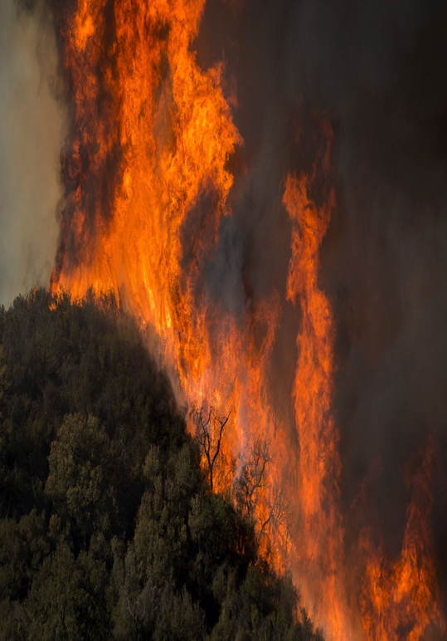
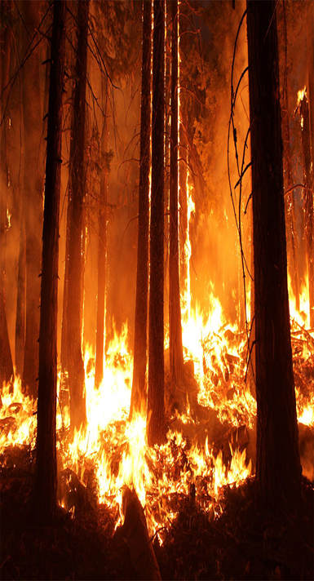
Wildfire
A wildfire is an uncontrolled fire that burns in the wild land vegetation, often in rural areas. Wildfires can burn in vegetation located both in and above the soil. Ground fires typically ignite in soil thick with organic matter that can feed the flames, like plant roots.

Slide 7
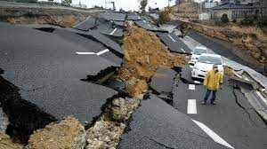
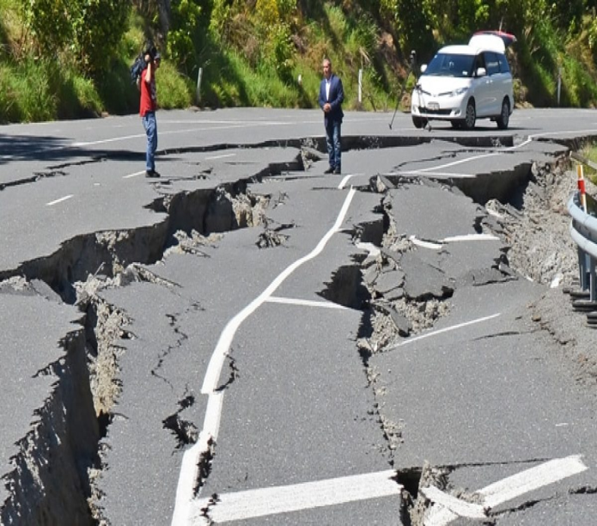
Earthquake
An earthquake (also known as a quake, tremor or temblor) is the shaking of the surface of the Earth resulting from a sudden release of energy in the Earth's lithosphere that creates seismic waves. Earthquakes can range in size from those that are so weak that they cannot be felt to those violent enough to propel objects and people into the air, and wreak destruction across entire cities. The seismicity, or seismic activity, of an area is the frequency, type, and size of earthquakes experienced over a period of time. The word tremor is also used for non-earthquake seismic rumbling.

Slide 8
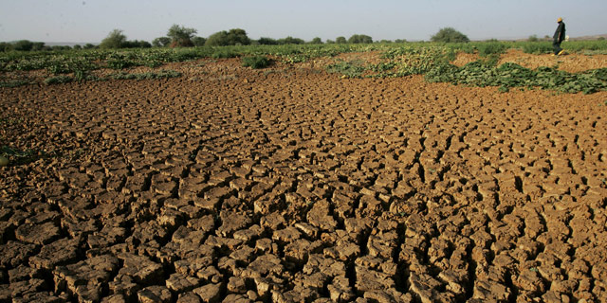
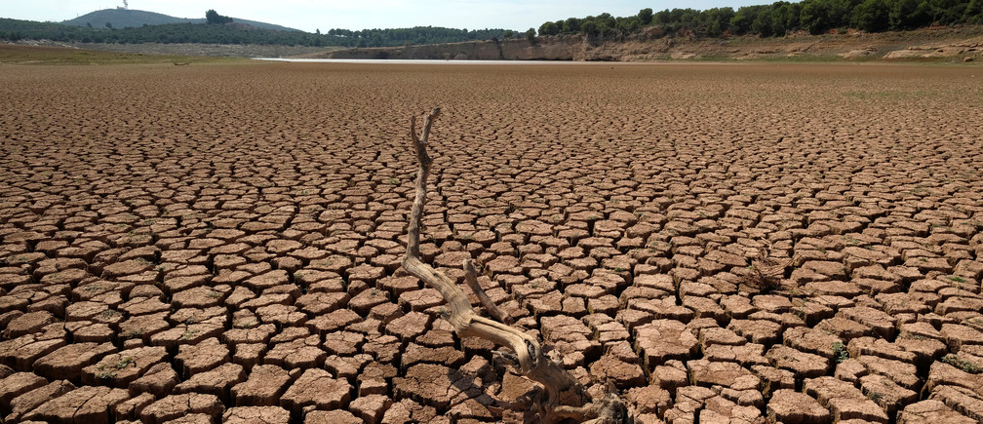
Drought
Drought is a prolonged dry period in the natural climate cycle that can occur anywhere in the world. It is a slow-onset disaster characterized by the lack of precipitation, resulting in a water. shortage. Drought can have a serious impact on health, agriculture, economies, energy.

Slide 9
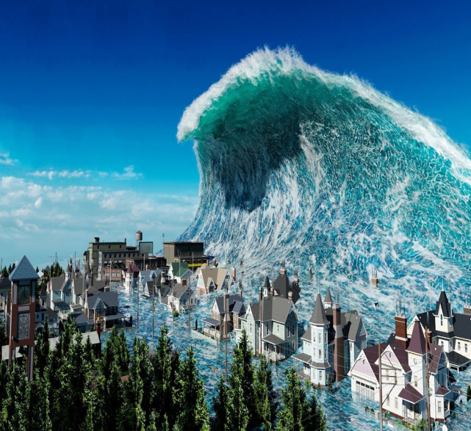
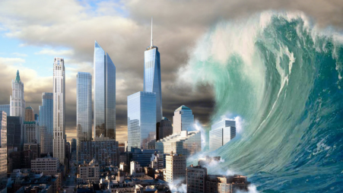
Tsunami
A tsunami is a series of waves caused by earthquakes or undersea volcanic eruptions. But as the waves travel inland, they build up to higher and higher heights as the depth of the ocean decreases. The speed of tsunami waves depends on ocean depth rather than the distance from the source of the wave.

Slide 10
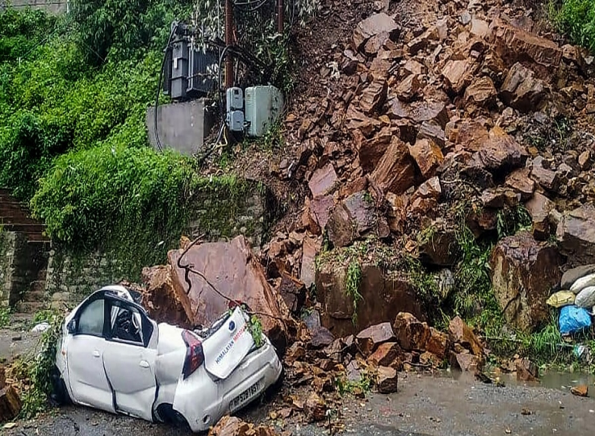
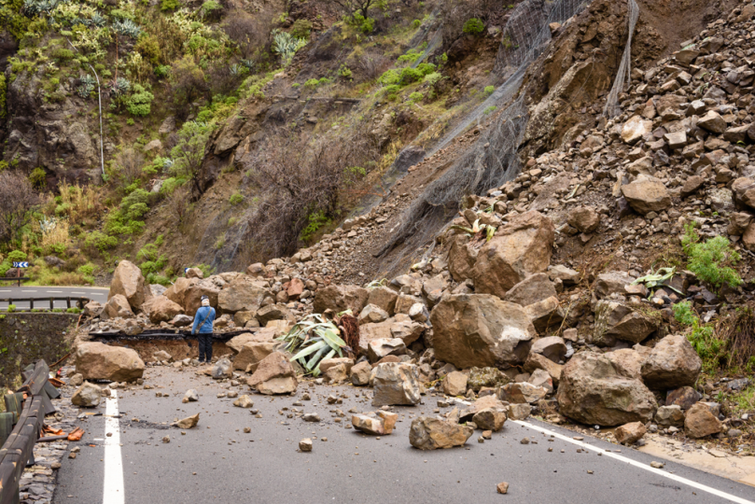
Land Slide
A landslide is the movement of rock, earth, or debris down a sloped section of land. Landslides are caused by rain, earthquakes, volcanoes, or other factors that make the slope unstable. Geologists, scientists who study the physical formations of the Earth, sometimes describe landslides as one type of mass wasting.

Slide 11
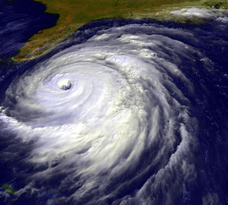
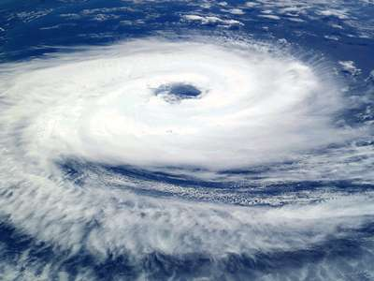
Cyclone
A cyclone is a system of winds rotating counterclockwise in the Northern Hemisphere around a low pressure center. The swirling air rises and cools, creating clouds and precipitation. Mid-latitude cyclones are the main cause of winter storms in the middle latitudes. Tropical cyclones are also known as hurricanes.

Slide 12
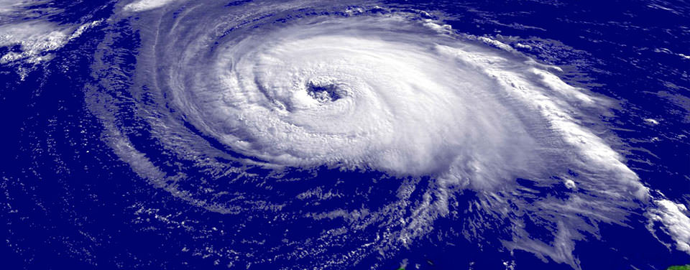
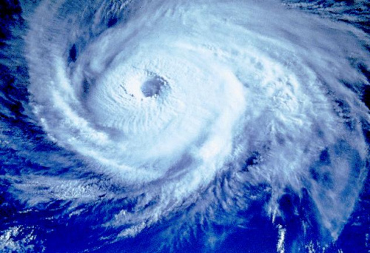
Typhoon/Hurricane
A typhoon is a mature tropical cyclone that develops between 180° and 100°E in the Northern Hemisphere. This region is referred to as the Northwestern Pacific Basin, and is the most active tropical cyclone basin on Earth, accounting for almost one-third of the world's annual tropical cyclones.

Slide 13


